Slide 1
Codecademy Data Analysis Intensive Capstone Project
Biodiversity for National Parks

Slide 2
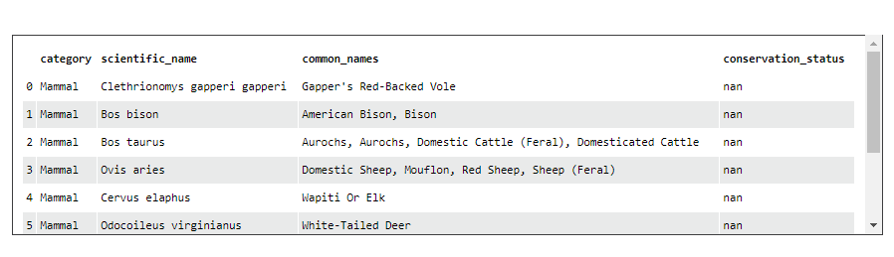
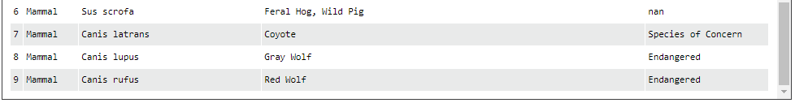
Data in species_info.csv
Above is ten top rows of the species_info.csv file
Species_info.csv file is based on the data from National Park Service
The file gives information about the scientific name of each
species, common name of each species, and conservation
status
There are 5541 different species in total
There are seven types of category to which species belong:
Mammal, Bird, Reptile, Amphibian, Fish, Vascular Plant, Non
Vascular Plant

Slide 3
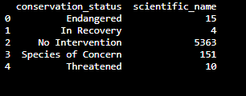
Data in species_info.csv
There are four types of conservation status in the file: Nan(No
Intervention) – 5363 species, Species of Concern – 151 species,
Endangered – 15 Species, Threatened – 10 species, In Recovery – 4
species

Slide 4
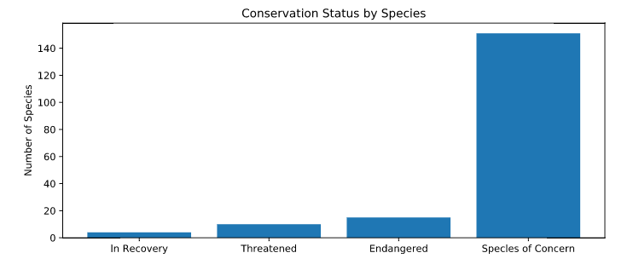
No. of Species Vs. Conservation Status

Slide 5
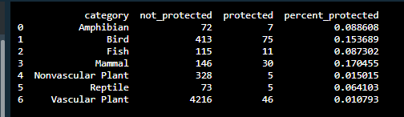
Endangered Species and Chi-Squared Tests
Chi-square tests indicate that the percentage protection difference
between Mammal and Bird is not significant and are as a result of
chance, whereas the percentage protection difference between
Mammal and Reptile is significant
Recommendations to Conservationists – The difference between
Mammal and Bird protection is not significant so they should focus on
both.

Slide 6
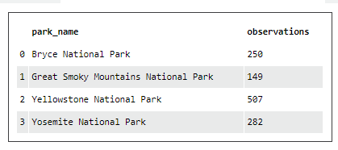
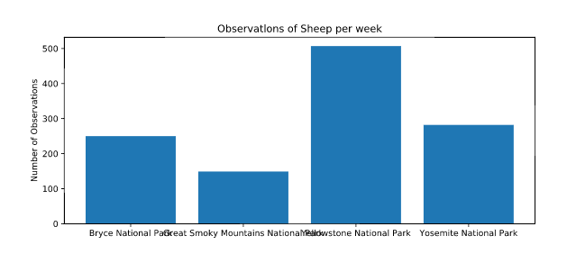
Sheep Observations

Slide 7
Sample size determination for foot and mouth disease
The baseline conversion rate is 15% as last year it was recorded that 15% of sheep at Bryce National Park have foot and mouth disease
Level of significance used is 90%
Minimum detectable effect was calculated to be 33.3% based on minimum percent change expected (5%) and baseline conversion rate(15%)
Sample size calculated using the above information was 510
Scientists need to spend one week at Yellowstone National Park and two weeks at Bryce National Park in order to observe enough sheep

